Slide 1



I’ve Seen “Enough” Incrementally Improving Visualizations to Support Rapid Decision Making
Sajjadur Rahman, Maryam Aliakbarpour, Ha Kyung Kong, Eric Blais, Karrie Karahalios, Aditya Parameswaran, Ronitt Rubinfield
University of Illinois (UIUC), MIT, University of Waterloo

Slide 2



Data Visualization
Microsoft’s Power BI hits 5m subscribers
Tableau software soars 17% on Q3 earnings
Notes:
data viz-> extract insights

Slide 3



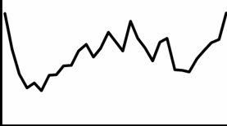
Visualizing Large Scale Data
Visualization
US Flight Data
(74m data points)
Delay
~60s
Time
Even delays > 0.5 seconds hamper insights! [Liu et al. 2015]
Key challenge: reveal insights within seconds!
Notes:
Traditional tools+Large dataset -> information extraction delayed

Slide 4
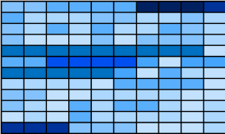
Motivation
Faster analysis of large datasets
Time series/Ordinal datasets → (trendlines, heatmaps)
Trendlines
Heatmaps

Slide 5
Motivation
Faster analysis of large datasets
Time series/Ordinal datasets → (trendlines, heatmaps)
Avg. Delay
How can we generate visualizations faster?
Time

Slide 6
How can we generate visualizations faster?
Pre-computation
data cubes (Nanocube, Profiler, Immense)
Dimensionality Reduction (M4)
Sampling

Slide 7
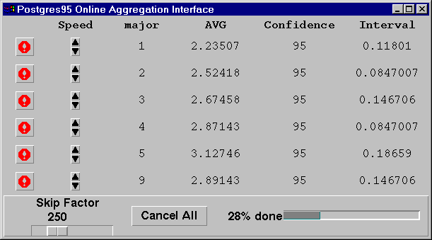
Sampling: Existing Solutions
Incremental
OLA (online aggregation)
sampleAction

Slide 8
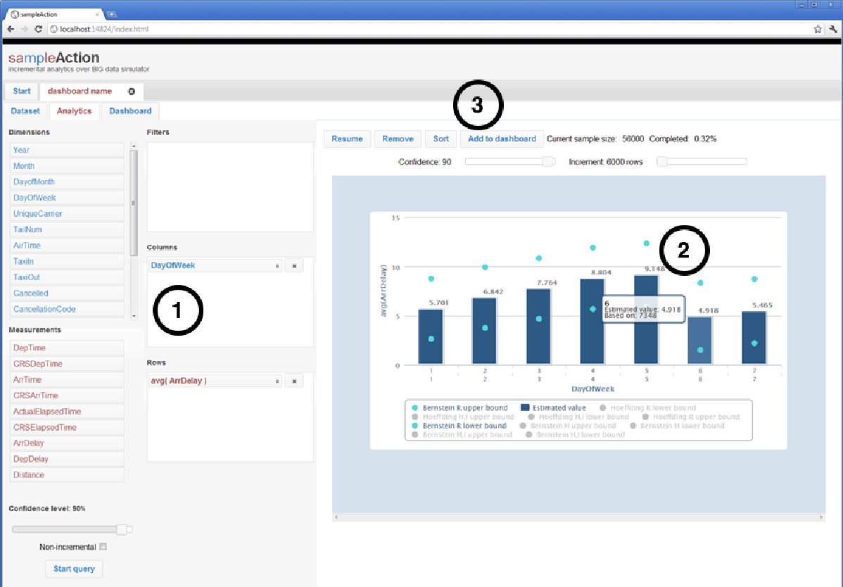
Sampling: Existing Solutions
Incremental
OLA (online aggregation)
sampleAction

Slide 9
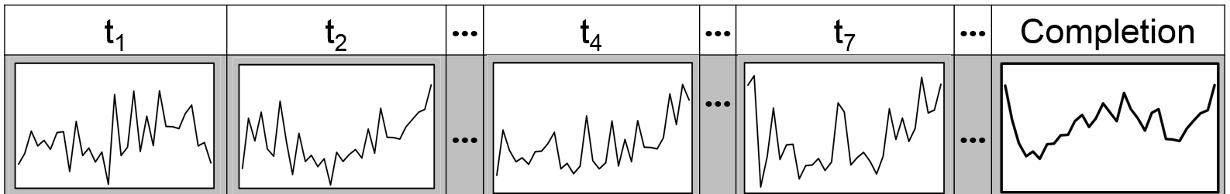
OLA Approach (2)
Standard approach: sampling based incremental visualization
t₁ | t₂ | … | t₄ | … | t₇ | … | Completion

Slide 10
OLA Approach (2)
Standard approach: sampling based incremental visualization
t₁ | t₂ | … | t₄ | … | t₇ | … | Completion

Slide 11
OLA Approach (2)
Standard approach: sampling based incremental visualization
t₁ | t₂ | … | t₄ | … | t₇ | … | Completion

Slide 12
OLA Approach (2)
Standard approach: sampling based incremental visualization
t₁ | t₂ | … | t₄ | … | t₇ | … | Completion

Slide 13
OLA Approach (2)
Standard approach: sampling based incremental visualization
t₁ | t₂ | … | t₄ | … | t₇ | … | Completion

Slide 14
Motivation (2)
Standard approach: sampling based incremental visualization
t₁ | t₂ | … | t₄ | … | t₇ | … | Completion
→Hard to draw conclusions
→Jarring experience/unstable
Can we do any better?
→Potentially incorrect

Slide 15
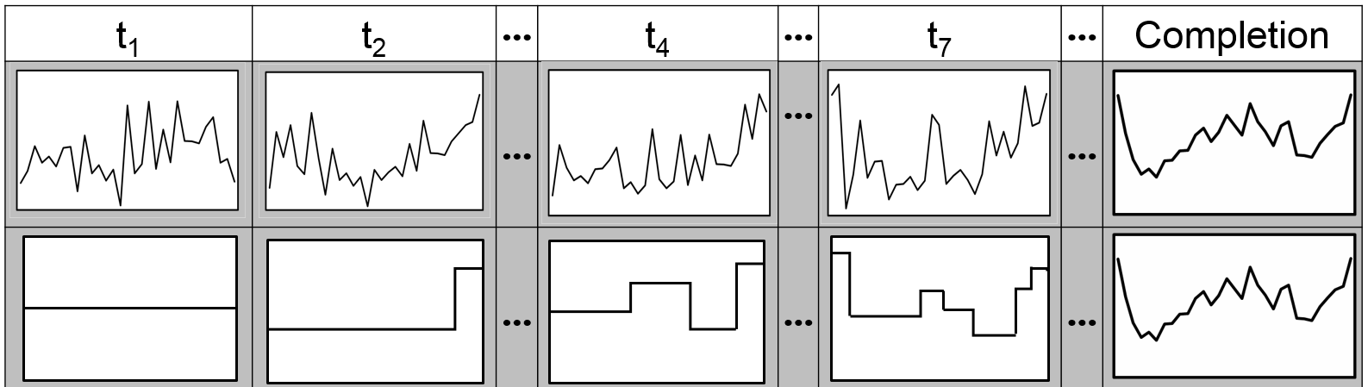
Incrementally Improving Visualizations
t₁ | t₂ | … | t₄ | … | t₇ | … | Completion
Standard
Incrementally
Improving
Show an increment when confident

Slide 16
Incrementally Improving Visualizations
t₁ | t₂ | … | t₄ | … | t₇ | … | Completion
Segment
Keep on sampling until confident

Slide 17
Incrementally Improving Visualizations
t₁ | t₂ | … | t₄ | … | t₇ | … | Completion
2-Segment
Approximation, L₂
Keep on sampling until confident

Slide 18
Incrementally Improving Visualizations
t₁ | t₂ | … | t₄ | … | t₇ | … | Completion
k-segment approximation at iteration k

Slide 19
Incrementally Improving Visualizations
t₁ | t₂ | … | t₄ | … | t₇ | … | Completion
emergent features

Slide 20
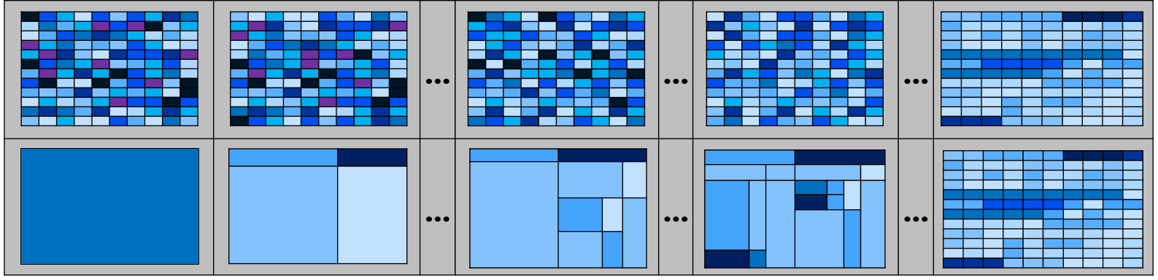
Incrementally Improving Visualizations
t₁ | t₂ | … | t₄ | … | t₇ | … | Completion

Slide 21
Incrementally Improving Visualizations
t₁ | t₂ | … | t₄ | … | t₇ | … | Completion
Draw conclusions with guarantees

Slide 22
Incrementally Improving Visualizations
Incrementally Improving | Standard
+ insights with guarantees | - no explicit guarantees on insights
+ important features first | - no notion of importance
+ incremental improvement | + incremental improvement
Rapid decision making!

Slide 23
Incrementally Improving Visualizations
Incrementally Improving | Standard
+ insights with guarantees | - no explicit guarantees on insights
+ important features first | - no notion of importance
+ incremental improvement | + incremental improvement
Any negatives?

Slide 24
Incrementally Improving Visualizations
Incrementally Improving | Standard
+ insights with guarantees | - no explicit guarantees on insights
+ important features first | - no notion of importance
+ incremental improvement | + incremental improvement
Any negatives?

Slide 25
Incrementally Improving Visualizations
Incrementally Improving | Standard
+ insights with guarantees | - no explicit guarantees on insights
+ important features first | - no notion of importance
+ incremental improvement | + incremental improvement
- information hidden | + display all the information

Slide 26
Incrementally Improving Visualizations
Incrementally Improving | Standard
+ insights with guarantees | - no explicit guarantees on insights
+ important features first | - no notion of importance
+ incremental improvement | + incremental improvement
- information hidden | + display all the information

Slide 27
Challenges
Algorithmic
how does the algorithm work?
Interface
how do the users interpret the visualizations?
Notes:
First, it is not clear at what rate we should be displaying the results of the incremental visualization algorithm. When can we be sure that we know enough to show the ith increment, given that the (i − 1)th increment has been shown already? How should the ith increment differ from the (i − 1)th increment? How do we prioritize sampling to ensure that we get to the ith increment as soon as possible, but with guarantees?
Can we show that our algorithm is in a sense ‘optimal’, in that it aims to take as few samples as possible to display the ith increment with guarantees?
And at the same time, how do we ensure that our algorithm is lightweight enough that computation doesn’t become a bottleneck?
How do we place the control in the user’s hands in order to control the level of interactivity needed?
Can users understand and make sense of the guarantees provided? Can they use these guarantees to make well-informed decisions and terminate early without waiting for the entire visualization to be generated?

Slide 28
Outline
Incrementally Improving Visualizations
Problem Statement
ISplit Sampling Technique
System Architecture
Performance Evaluation and User Study
Discussion

Slide 29
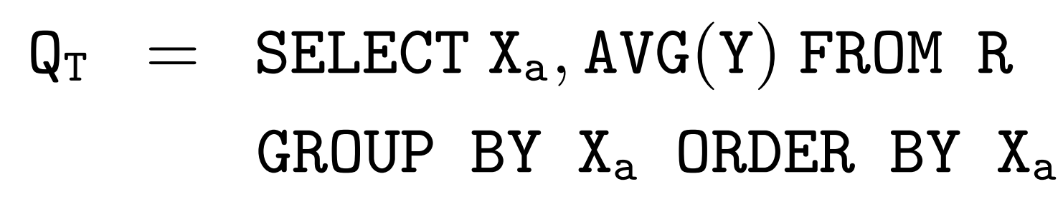
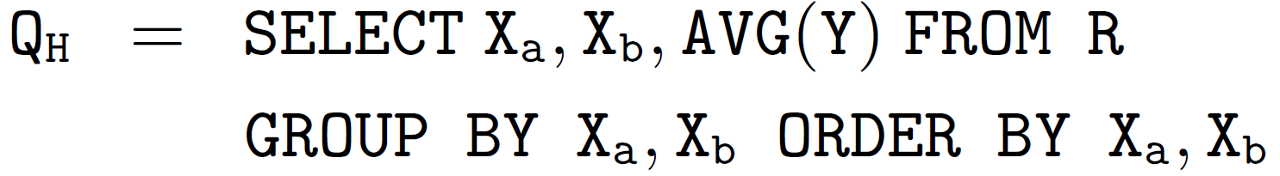
Problem Statement: Query Type
AVG(Y)
Delay (AVG (Y))
X_{b}
Time (X_{a})
X_{a}
Notes:
replace this image with completion image

Slide 30
Problem Statement: Query Type
AVERAGE
SUM
COUNT
Delay (AVG (Y))
Time (X_{a})
Notes:
replace this image with completion image

Slide 31

Problem Statement
Input: Dataset D, Query Q_{T}/Q_{H}, Parameters (δ, Є)
Output: incrementally improving visualization
k-segment approximation at iteration k
Є close to the best k-segment approximation (with high probability)
t₁ | t₂ | … | t₄ | … | t₇ | … | Completion

Slide 32
Outline
Incrementally Improving Visualizations
Problem Statement
ISplit Sampling Technique
System Architecture
Performance Evaluation and User Study
Discussion

Slide 33
Ideal Scenario: Means are Known
No samples are drawn (ISplit-Best)
Find the best k-segment approximation per iteration
Refine segment S: split S into segments T and U
S
But where do we split?
Notes:
animate this slide

Slide 34
Ideal Scenario: Where to Split?
T
U
|T| → Segment Size
μ_{T} → Segment Mean
S
→Large segment size
→Higher delta between values
…
μ_{U}
μ_{T}
Notes:
animate this slide

Slide 35
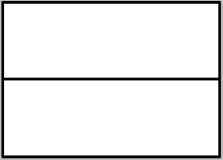
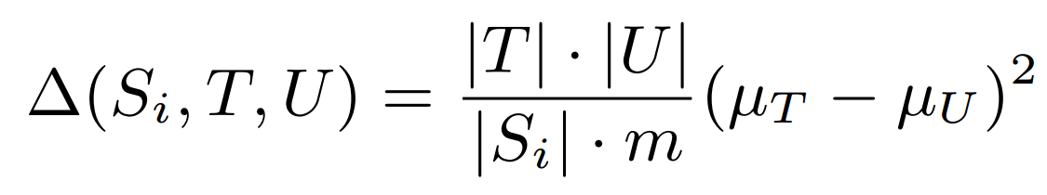
Ideal Scenario: Key Concept
T
U
S
t₁
t₂
How does the algorithm work?
Improvement Potential
|T| → Segment Size
μ_{T} → Segment Mean
Notes:
animate this slide

Slide 36
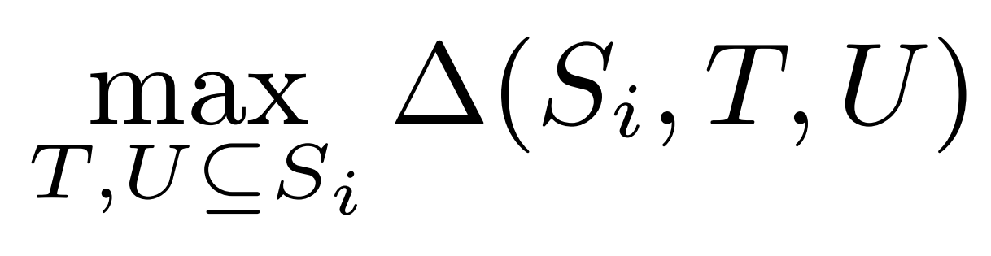
Ideal Scenario: Which Segment to Split?
?
S₁
S₂
t₂
t₃
Notes:
animate this slide

Slide 37
Ideal Scenario: Which Segment to Split?
S₁
S₂
t₂
t₃
Notes:
animate this slide

Slide 38
Online Sampling Scenario
Draw Samples (ISplit)
determine the sample complexity
Find the k-segment approximation per iteration
select the refinement given samples
Notes:
animate this slide

Slide 39
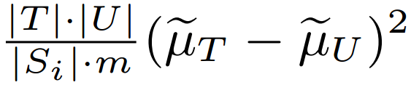
Select the Refinement Given Samples
Maximize empirical improvement potential
Notes:
animate this slide

Slide 40
Problem Statement
Input: Dataset D, Query Q_{T}/Q_{H}, Parameters (δ, Є)
Output: incrementally improving visualization
k-segment approximation at iteration k
Є close to the best k-segment approximation (with high probability)
t₁ | t₂ | … | t₄ | … | t₇ | … | Completion

Slide 41
Select the Refinement Given Samples
Maximize empirical improvement potential
How to ensure?
Notes:
animate this slide

Slide 42
Select the Refinement Given Samples
Maximize empirical improvement potential
Quality of refinement → estimates of the segment mean
Notes:
animate this slide

Slide 43
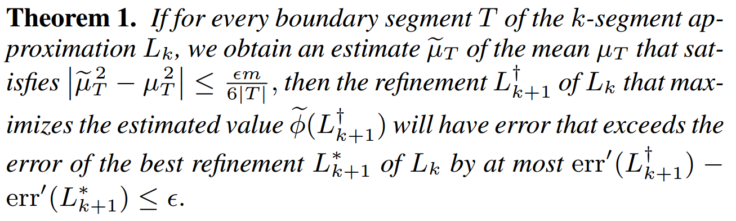
Select the Refinement Given Samples
Maximize empirical improvement potential
Quality of refinement ← Estimates of the segment mean
Notes:
animate this slide

Slide 44
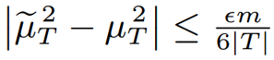
Determine the Sample Complexity
How much sample should we draw to satisfy the guarantees?
Notes:
animate this slide

Slide 45
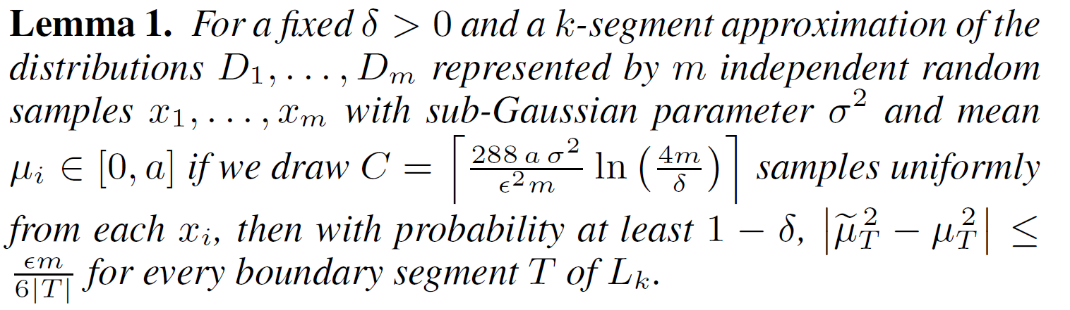
Determine the Sample Complexity
Uniform sampling per iteration → optimal
Notes:
animate this slide

Slide 46
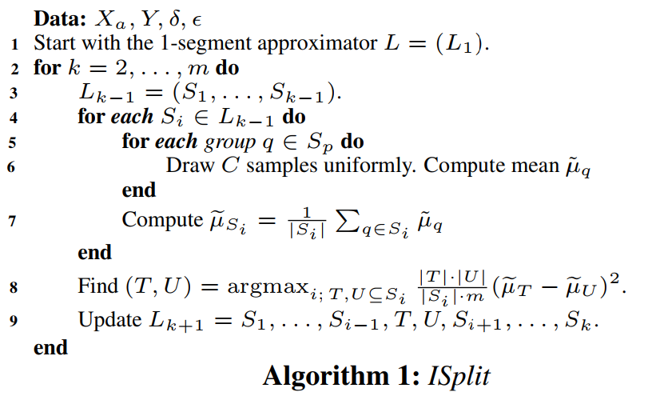
The ISplit Algorithm
Sampling
Repeat
Split
Notes:
animate this slide

Slide 47
Tuning Є Across Iterations
Uniform samples (kC)
later iterations take the same time
provide minor updates
Notes:
animate this slide

Slide 48
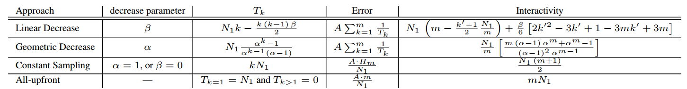
Tuning Є Across Iterations
Uniform samples (kC)
later iterations take the same time
provide minor updates
Notes:
animate this slide

Slide 49
IncVisage In Action!

Slide 50
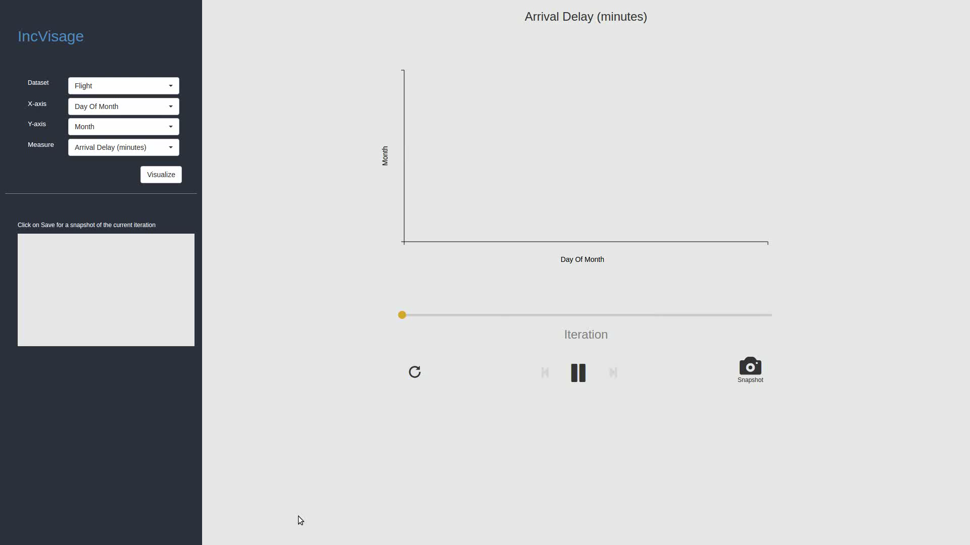

Slide 51
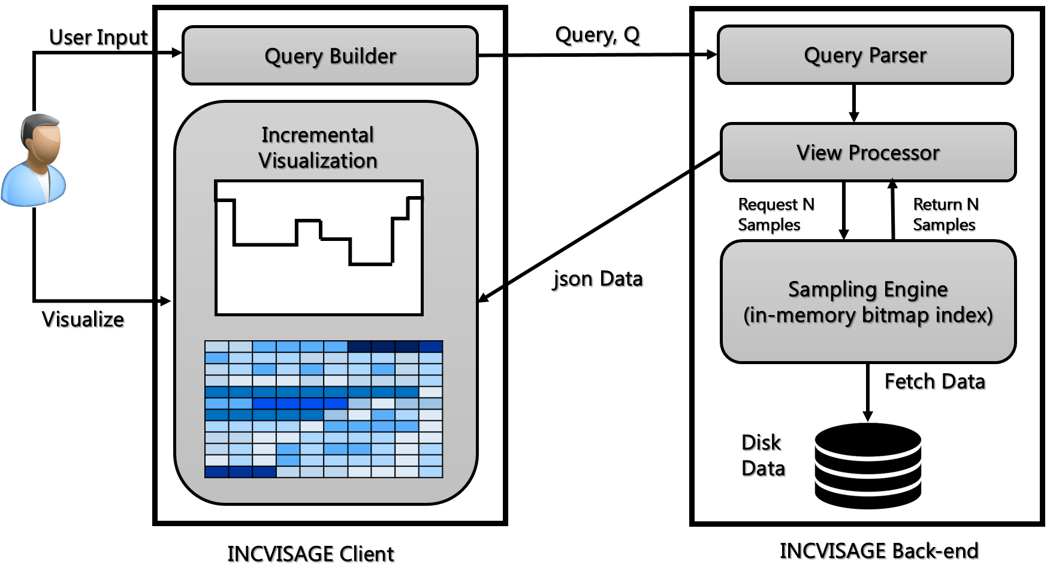
System Architecture

Slide 52
Outline
Incrementally Improving Visualizations
Problem Statement
ISplit Sampling Technique
System Architecture
Performance Evaluation and User Study
Discussion

Slide 53
Evaluation
Performance
ISplit vs Baseline
Usability
interpretability
decision making (IncVisage vs Standard)

Slide 54
Metrics and Algorithms
Wall clock time (sec)
Error per iteration
Algorithm | Basic Idea
ISplit | Incremental improvement
ISplit-Best | Incremental improvement + Ideal
RSplit | Random Splitting
DPSplit | Releasing the refinement restriction
Scan | Sequentially read entire dataset

Slide 55
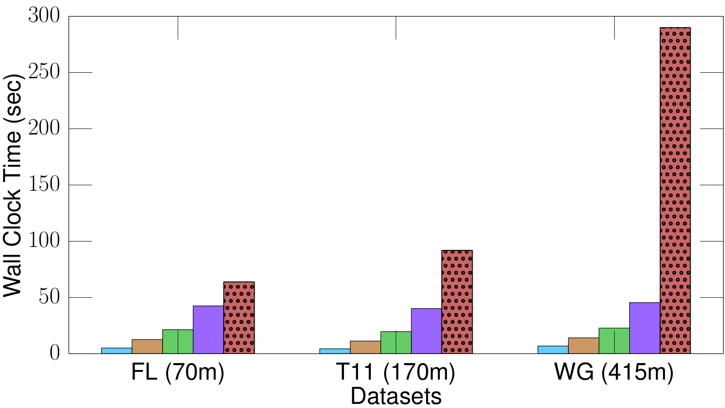
Evaluation: Execution Time
Completion
50
10
Scan
5

Slide 56
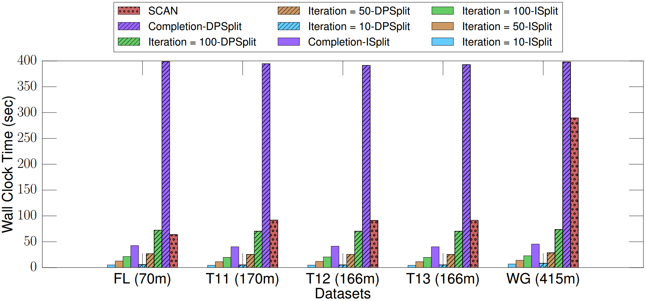
Evaluation: Execution Time

Slide 57
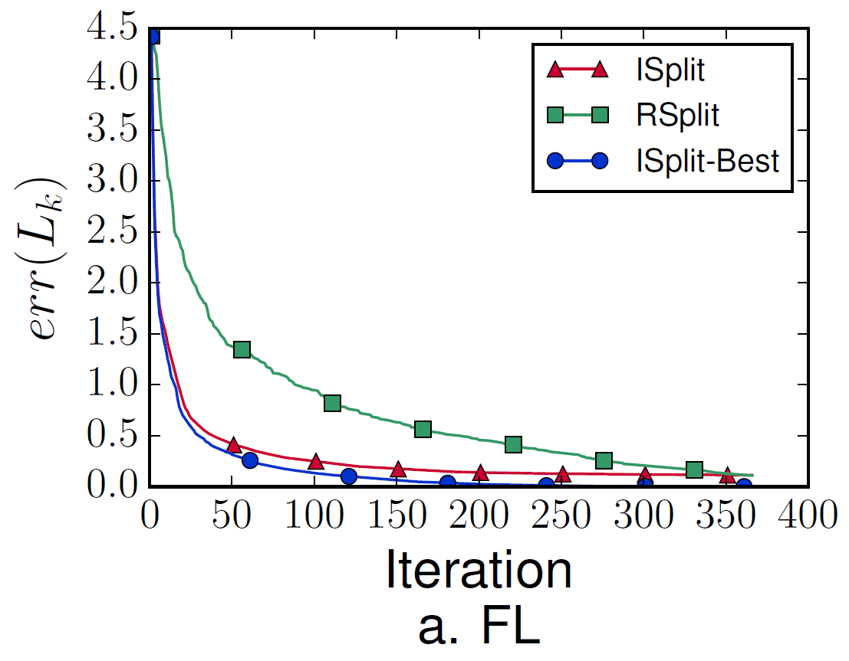
Evaluation: Incremental Improvement Evaluation
Error (ISplit < RSplit) TRUE
Error
Iteration
(US Flight Dataset)

Slide 58
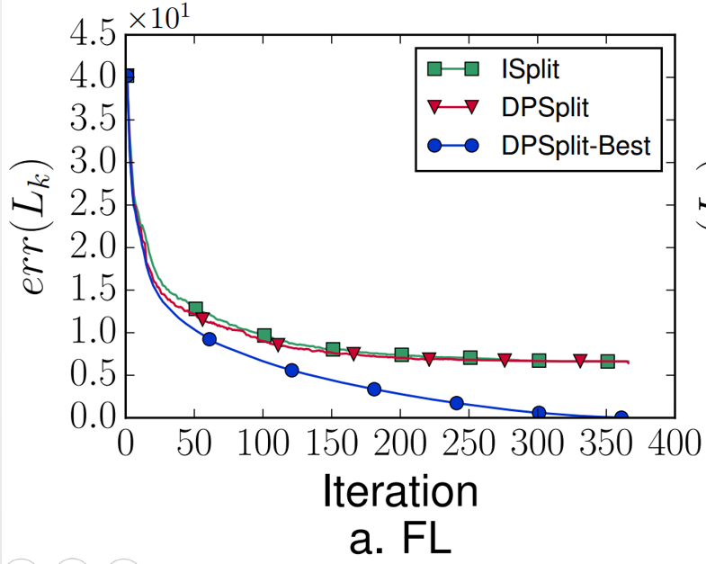
Evaluation: Releasing the Refinement Restriction
Error
Iteration
(US Flight Dataset)

Slide 59
Evaluation: Usability
Two user studies
interpretability of IncVisage
comparison with the standard approach
Find the busiest day of the year ORD airport. The higher the Taxi Out time, the busier the airport.
Choose the correct option based on the Day of the Year. UA aircrafts have the worst Aircraft Delay statistics on: a) Jan 01-Jan 10 b) Jan 10-Jan 20 c) Dec 01-Dec 10

Slide 60
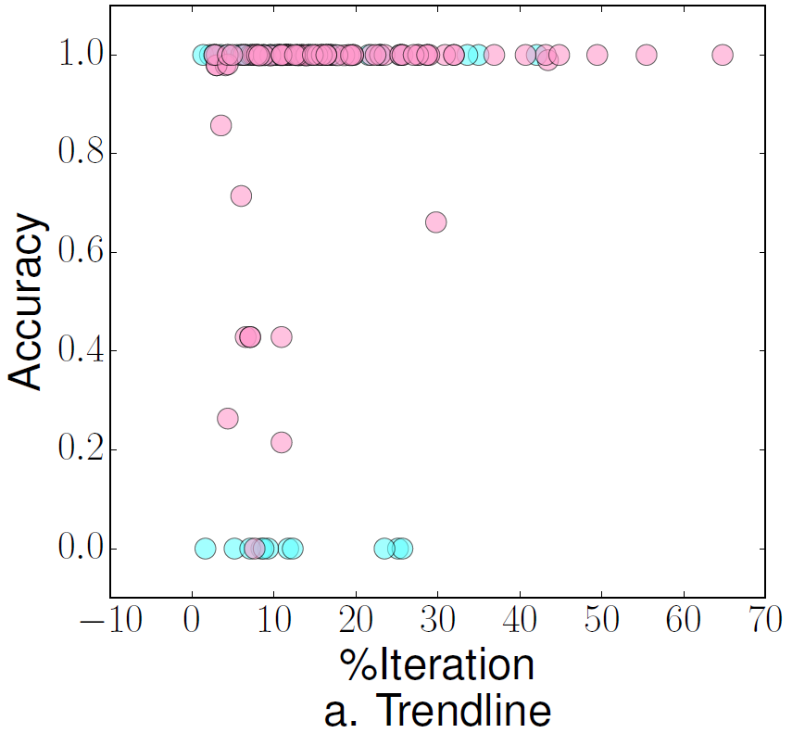
Evaluation: Interpretability
Criteria | Trendlines
Confidence (10) | 8.5
Interpretability (5) | 4.50
Satisfaction (5) | 4.55

Slide 61
Evaluation: Decision Making
Approach | Extrema Based Questions |  | Range Based Questions
 | Accuracy | Time (sec) | Accuracy | Time (sec)
IncVisage | 94.55% | 25.0638 | 62.50% | 22.0822
Standard | 45.83% | 26.4022 | 52.50% | 27.3125
“… easier to know when I wanted to stop”
”… really interesting to watch over time”
“… easier to narrow down the range when looking for answers”

Slide 62
Outline
Incrementally Improving Visualizations
Problem Statement
ISplit Sampling Technique
System Architecture
Performance Evaluation and User Study
Discussion

Slide 63
Discussion
Comments, limitations?
algorithmic
interface

Slide 64
Discussion Q1
Lets say, the user wants to find the date where highest delay occurs. But the top two higher delay dates are consecutive (December 22 and 23). ISplit cannot quickly reveal which of these two dates is the highest delay date. Why?

Slide 65
Discussion Q1
Lets say, the user wants to find the date where highest delay occurs. But the top two higher delay dates are consecutive (December 22 and 23). ISplit cannot quickly reveal which of these two dates is the highest delay date. Why?
Improvement Potential
split where delay between the two values are large enough

Slide 66
Discussion Q1
Lets say, the user wants to find the date where highest delay occurs. But the top two higher delay dates are consecutive (December 22 and 23). ISplit cannot quickly reveal which of these two dates is the highest delay date. Why?
Improvement Potential
split where delay between the two values are large enough
Approximation: not that far off from the exact answer
user might make a wrong guess

Slide 67
Discussion Q2
Can ISplit prioritize which feature to reveal? For example, user wants to find the date with the lowest delay.

Slide 68
Discussion Q2
Can ISplit prioritize which feature to reveal first? For example, user wants to find the date with the lowest delay.
No

Slide 69
Discussion Q2
Can ISplit prioritize which feature to reveal? For example, user wants to find the date with the lowest delay.
No
Any alternatives?

Slide 70
Discussion Q2
Can ISplit prioritize which feature to reveal first? For example, user wants to find the date with the lowest delay.
No
Any alternatives?
Weighted Improvement Potential?
Weight each choice of split point
Weight can be a function of user preference
Rank of the split point in the current order of lower delay points

Slide 71
Discussion Q3
Since ISplit estimates the means, how can we model the uncertainty associated with the results generated?

Slide 72
Discussion Q3
Since ISplit estimates the means, how can we model the uncertainty associated with the results generated?
No runaway winner for error modeling
error bar

Slide 73
Discussion Q3
Since ISplit estimates the means, how can we model the uncertainty associated with the results generated?
No runaway winner for error modeling
error bar
How can we model uncertainty for heatmaps?

Slide 74
Discussion Q3
Since ISplit estimates the means, how can we model the uncertainty associated with the results generated?
No runaway winner for error modeling
error bar
How can we model uncertainty for heatmaps?
Interface perspective

Slide 75
Discussion Q3
Since ISplit estimates the means, how can we model the uncertainty associated with the results generated?
No runaway winner for error modeling
error bar
How can we model uncertainty for heatmaps?
Interface perspective
Overlay OLA with ISplit

Slide 76
Discussion Q4
Lets say, user has already found some features of interest and now wants to get their exact value. How can we extend the current system to support that?

Slide 77
Discussion Q4
Lets say, user has already found some features of interest and now wants to get their exact value. How can we extend the current system to support that?
Optimistic visualization: run full scan of data on the background for an approximate viz. for which user wants exact answer.

Slide 78
Discussion Q4
Lets say, user has already found some features of interest and now wants to get their exact value. How can we extend the current system to support that?
Optimistic visualization: run full scan of data on the background for an approximate viz. for which user wants exact answer. Alternatives?

Slide 79
Discussion Q4
Lets say, user has already found some features of interest and now wants to get their exact value. How can we extend the current system to support that?
Optimistic visualization: run full scan of data on the background for an approximate viz. for which user wants exact answer.
User selects portions of interest
Run full Scan on the specific groups at the background

Slide 80
Discussion Q5
Why decrease the number of samples geometrically? Is it the best approach?
Natural: linear or geometric decrease
What are the alternatives?

Slide 81
Discussion Q5
Why decrease the number of samples geometrically? Is it the best approach?
Natural: linear or geometric decrease

Slide 82
Discussion Q5
Why decrease the number of samples geometrically? Is it the best approach?
Natural: linear or geometric decrease
What are the alternatives?
Other progression models that captures the interactivity factor

Slide 83
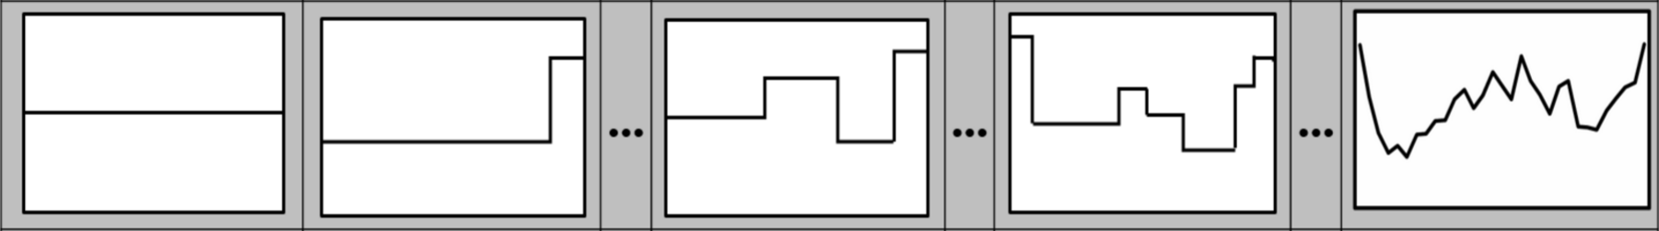
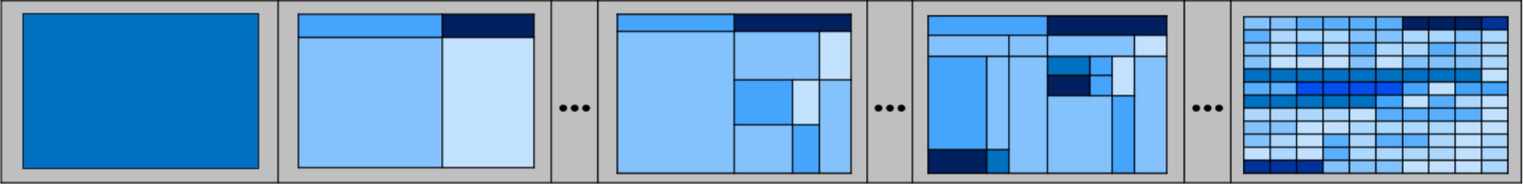
Thank You!
t₁ | t₂ | … | t₄ | … | t₇ | … | Completion
Our code is open-sourced: https://github.com/zenvisage/incvisage
Please download and give us feedback!

Slide 84
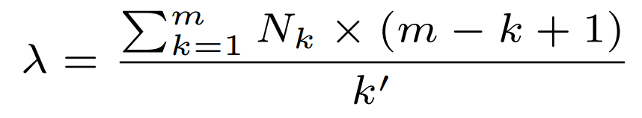
Evaluation
Justifying Geometric Decrease Factor

Slide 85
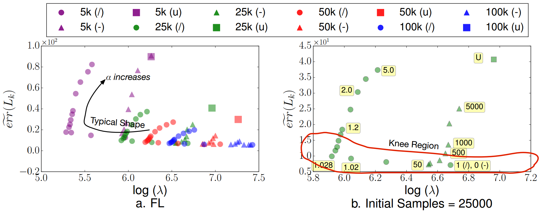
Evaluation: Parameter Selection

Slide 86
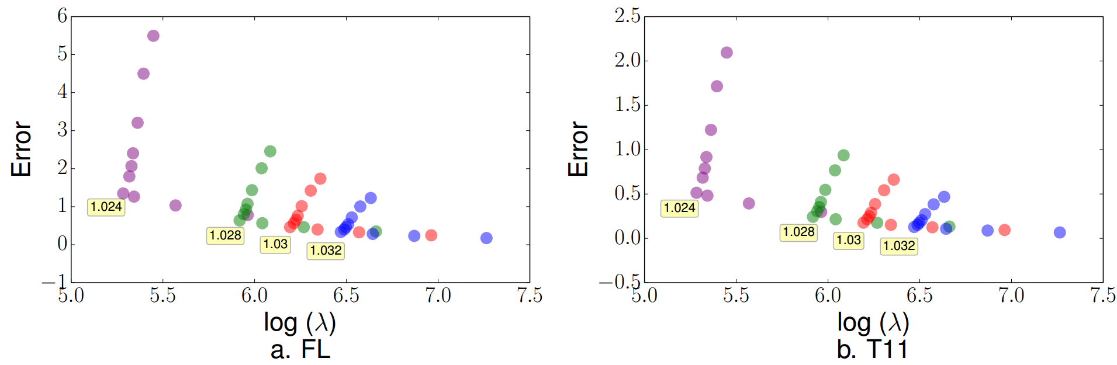
Evaluation: Simulation VS Empirical Observation

